Slide 1

A Predictive Model for Hotel Booking Status and Cancellation Risk
Data-driven insights for better customer retention
Presented by:
Kuroyefa Leghemo
Date Presented:
May 16th, 2026
1

Slide 2
Outline
Business Introduction
Problem Statement
Objectives
Key Business Questions
Data Description
Methodology
Insights
Model Performance Evaluation
Recommendations
Conclusions

Slide 3

Business Introduction
Hotel Haven is a luxury hotel chain with multiple locations that offers a wide range of services including rooms, meal plans, and parking services

Slide 4
Problem Statement
01
02
03
Struggle with high cancellation rate
Lost revenue and inefficient resource allocation
Limited insight into cancellation reasons
Notes:
Background: The hospitality industry operates on one critical principle: Inventory is perishable.
An unsold hotel room tonight can never be sold again tomorrow. Because of this, hotel booking cancellations or no-shows translates to direct operational losses. Staff allocated to that room are still paid for the unproductive hours, utilities are consumed in preparation for a guest who never arrives, and the window to resell that room to another guest shrinks.

Slide 5
Clean and prepare the hotel booking dataset for analysis and modeling
Explore booking data to understand patterns, and cancellation behavior
Perform comprehensive analysis to identify key factors influencing booking cancellations
Engineer meaningful features that improve analysis and model performance
Develop a machine learning model to predict booking status accurately
Evaluate model performance using appropriate metrics for classification
Fine-tune the model to improve accuracy and reliability
Generate actionable insights that support better customer retention and reduce cancellations
Objectives

Slide 6
Key Business Questions
Questions Addressed
How does cancellation compare to honored bookings in Hotel Haven?
What is the financial impact of cancellations on Hotel Haven’s revenue? Are higher-priced bookings cancelled more than lower-priced ones? Are expensive bookings made far in advance more likely to be canceled?
Are guests booked into certain room types more likely to follow through with their reservations?
Does the market segment through which a guest books influence their booking status at Hotel Haven?
Is the number of special requests a reliable signal of a guest's intention to honor their booking?

Slide 7
Data Description
Source of Data: 10Alytics
Size : 36,285 rows x 17 columns (16 features and 1 target) bookings records
Period : Feb 2015 - December 2018 (3 years, 11 months)
Key Features : booking ID, number of adults, number of children, number of weekend nights, number of weeknights, type of meal, car parking space, room type, lead time, market segment type, repeat, P-C, P-NOT-C, average price, special requests, date of reservation, booking status

Slide 8
Methodology
CRISP DM approach adopted
Data Cleaning and Preprocessing
Relevant libraries imported and the dataset(CSV file) was loaded into jupyter notebook
Data exploration done to understand the data types, quality and structure
Descriptive analysis performed to summarize key metrics
37 booking records were found to contain an invalid date; February 29, 2018 ( not a leap year), a possible system bug or data entry error during that period. All affected records were corrected to February 28, 2018
No missing or duplicated values
Wrong data type corrected appropriately
01

Slide 9
Methodology
Exploratory Data Analysis
Features engineering: revenue column generated to enhance analysis
Comprehensive data analysis and visualizations were done to uncover patterns in factors influencing booking cancellations
Data Preprocessing (cont’d)
Irrelevant and repetitive columns were dropped (P-C and P-not = repeated)
Outliers were investigated and removed
Encoding of categorical variables
Scaling of numerical data with Robust Scaler (mild - heavy skewness)
The target had class distribution inbalanced (67:33 ), which was handled using (Synthetic Minority Oversampling Technique (SMOTE)
01
Final Cross-Validation
Notes:
Booking ID, P-C and P-not-C
Repetitive columns: The columns P-C, P-not-C had similar information with the column for ‘repeated’

Slide 10
Methodology
Modelling
Trained Baseline Model - Logistic Regression model (78% prediction accuracy, F1-score and recall)
Trained Multiple Advanced Classification Models
Random Forest (best performance)
Gradient Boosting
Ada Boost
SVC
K Nearest Neighbours
Decision Tree
XG Boost
01
Hyperparametric tunings

Slide 11
Methodology
Tools
Python (Jupyter Notebook)
Libraries;
Matplotlib
Pandas
Seaborn
Scikit Learn
XG Boost
Imbalanced-learn
Dateutil

Slide 12
Hotel Haven Key Performance Metrics
87%
36,285
$7M
32.8%
$4.2M
85 Days
Total Hotel Bookings
Total Revenue
Generated
Total Cancellation Rate
Total Revenue
Loss
Average Lead Time

Slide 13
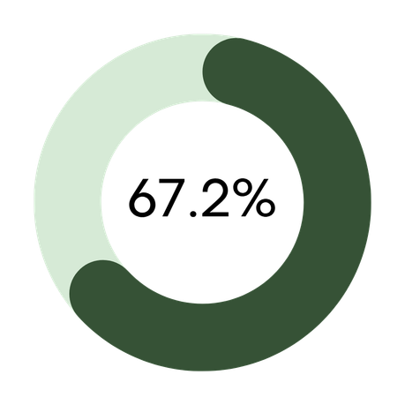
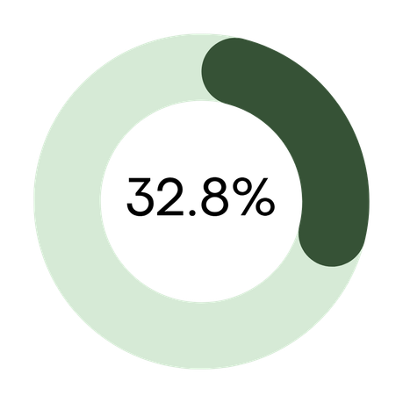
Insights
VS
Honored Bookings
(24,396)
Cancelled Bookings
(11,889)
Figure 1: Booking Status Overview at Hotel Haven
Notes:
Insight: 1 in 3 bookings were cancelled, which is significantly

Slide 14
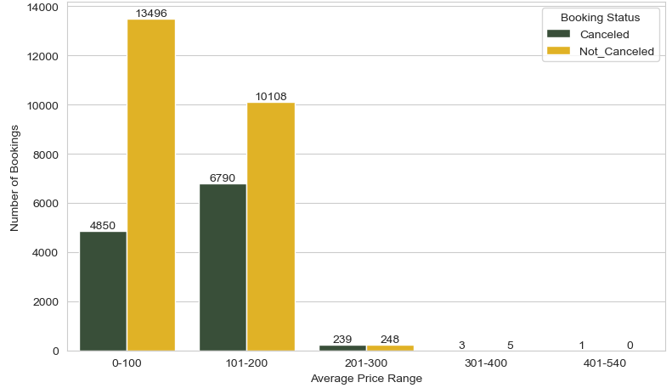
Key Insights
The $101-$200 price range is Hotel Haven's biggest cancellation problem, with nearly 7,000 cancellations, representing the greatest source of lost revenue for the hotel
Hotel Haven attracts very few premium bookings ($301-$540)
Figure 2: Distribution of Booking Status by Average Price
Notes:
Budget to mid-range rooms ($0-$200) dominate Hotel Haven's bookings, with the hotel's revenue and cancellation risk both heavily concentrated in this segment, suggesting price as strong predictor of cancellations

Slide 15
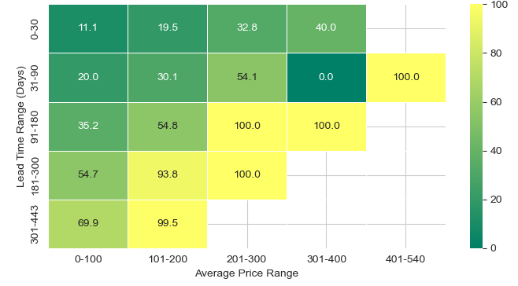
Key Insights
Lead time is the dominant cancellation driver, regardless of the price
Guests who book <=30 days before arrival are far more likely to follow through
Figure 3: Cancellation Rate (%) by Average Price Range and Lead Time
Notes:
Lead time is the dominant cancellation driver: the longer a guest books in advance, the more likely they are to cancel, regardless of price
Short lead time bookings are the safest: Guests who book <=30 days before arrival are far more likely to follow through, making them Hotel Haven's most dependable customer segment for resource planning

Slide 16
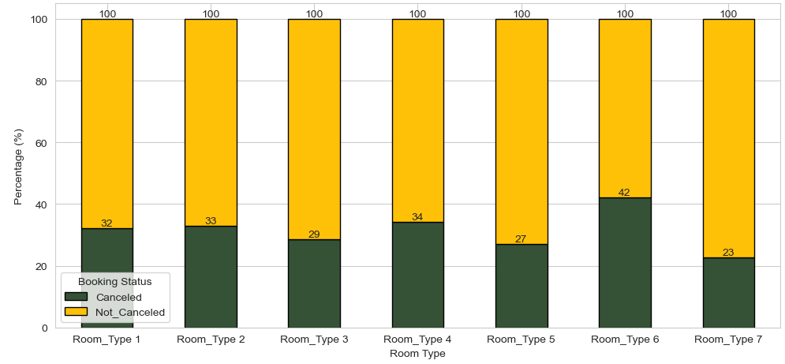
Key Insights
No clear/consistent pattern of cancellation rate across room types
Slight variations suggests that room type alone is not a a strong predictor of cancellations
Figure 4: Percentage Distribution of Booking Status by Room Type
Notes:
Room Type 6 has highest cancellation rate (42%), slightly higher, making it Hotel Haven's most at-risk room inventory, Room Type 7 is the most reliable with the lowest cancellation rate (23%)
The absence of descriptive information about each room type limits our ability to explain why certain room types experience higher cancellation rates than others

Slide 17
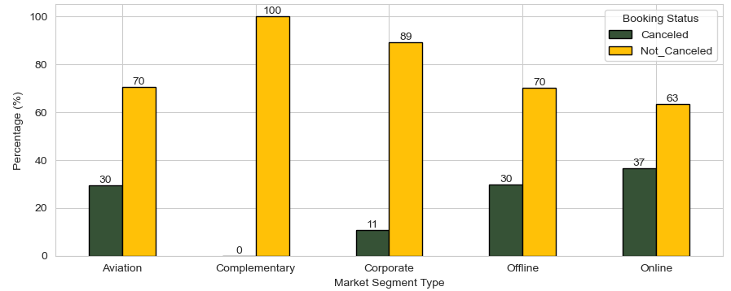
Key Insights
The seamless booking and cancellation of the online booking channel directly contributes to revenue and inefficient resource allocation at a cancellation rate of 37%.
With only 11% cancellation rate, corporate guests demonstrate strong booking commitment.
Figure 5: Percentage Distribution by Market Segment
Notes:
With only 11% cancellation rate, corporate guests demonstrate strong booking commitment, representing a stable and predictable revenue stream and efficient resource planning segments and inefficient resource allocation at a cancellation rate of 37%
Complementary bookings have a 0% cancellation rate, strategic bookings provided at no charge to partners, loyalty members, or media, guests have no reason to cancel. While they generate no direct revenue, they can serve as a basis for revenue generation via verbal referrals, and positive reviews for Hotel Haven

Slide 18
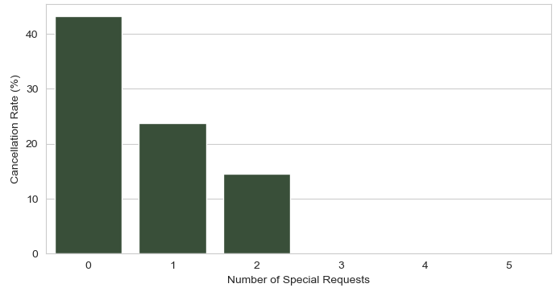
Key Insights
Special request is a reliable signal of booking commitment. Each additional special request made at booking significantly reduces the likelihood of cancellation.
Guests with zero special requests cancel at 43%, making them Hotel Haven's highest cancellation risk segment
Figure 6: Cancellation Rate by Number of Special Requests
Notes:
No commitment = 43.2% cancelled, 1 special request = 23.8% cancelled, 2 special request = 14.6% cancelled, 3-5 = nil request

Slide 19
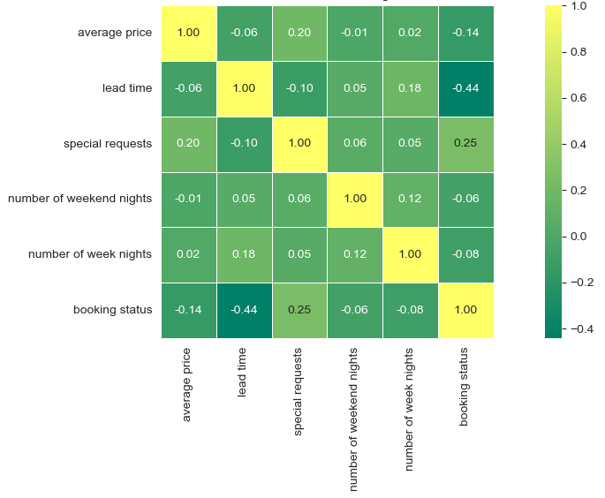
Key Insights
Lead time (negative predictor), special requests and (positive predictor) are the factors which mostly influence booking status at Hotel Haven reinforcing our earlier finding.
Price is a weak predictive factor
Figure 6: Correlation Matrix of Booking Variables

Slide 20
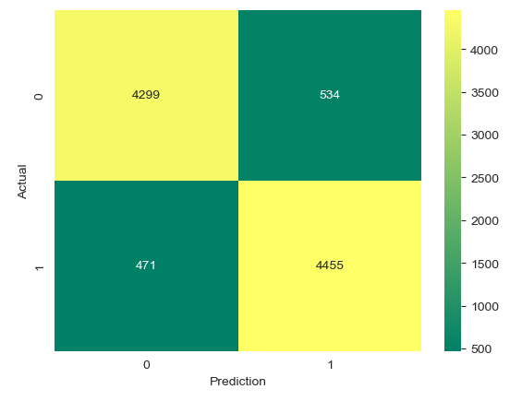
Model Performance Evaluation
Figure 7: Confusion Matrix: For Random Forest Model

Slide 21
Model Performance Evaluation
Accuracy: 90% (correctly classified prediction)
F1 Score: 90% (balanced precision and recall)
Recall: 89-90% (correctly flags cancellation)
Precision: 89-90% (low false alarm rate)
ROC-AUC: 96% (strong class readability)
Write a note here
Notes:
Business Implication: The model demonstrated strong predictive performance, with 90% accuracy, 90% F1 score, and a 96% ROC-AUC score, indicating that it can reliably identify booking cancellations and support better operational decision-making and improve profitability.

Slide 22
Recommendation
Price and Booking Commitments
Use deposits, prepaid rates, or credit card to increase booking commitment
Offer flexible options such as rescheduling or partial refunds instead of full cancellation for lower priced rooms, giving budget guests a financial incentive to commit at the point of booking
Market Segments
Room upgrades or loyalty reward to guests who book directly (offline market segment)
Lead Time
Identify long lead-time bookings at an early stage and proactively engage these guests with personalized campaigns, promotional upgrades and experience packages
Offer small incentives for guests who keep long-lead bookings

Slide 23
Recommendation
Room Type
Improve listing accuracy by ensuring room descriptions, photos, amenities, and prices match the actual experience
Market Segment
Actively grow the corporate segment by proactive contracts negotiation and corporate rate agreements with companies, and travel agencies, as their accommodation partner for corporate travellers
Incorporate more options in special-request fields

Slide 24
Conclusion
Hotel cancellations is a major financial burden in the hospitality industry as it causes revenue loss, poor allocation of resources, and reduced profitability
For Hotel Haven, this problem is especially significant, with a recorded revenue loss of $4.2 million from a 32.8% cancellation rate over a 3 years, 11 months period
While they are not the direct causes of cancellations, lead time, special requests and pricing are the strongest predictors of cancellations
By leveraging machine learning models, Hotel Haven can make proactive, data-driven decisions that move the business from reacting to cancellations to preventing them, ultimately reducing cancellation rates, improving profitability, and strengthening overall business performance

Slide 25
Thank You

Slide 26
Reference
D-EDGE (2024). Hotel Distribution Report. Available at: https://www.d-edge.com/avoid-guests-ghosting/
HotelMinder (2024). Reduce Hotel Cancellations: 8 Practical Tips. Available at: https://www.hotelminder.com/8-tips-to-reduce-last-minute-hotel-cancellations-and-no-shows
Smart Order. (2025). Hotel Minimize Hotel Booking cancellation. Available at: https://www.smartorder.ai/resources/blog/how-to-minimize-hotel-booking-cancellations/

